Slide 1

Sketch Hub
Connecting Artists & Clients — A locally hosted web platform bridging creative talent with those who seek it.

Slide 2

Abstract
SketchHub is a locally hosted web-based platform designed to connect clients with artists in an easy and convenient way. Clients find artists based on required art categories — pencil portraits, watercolor, acrylic painting, wall art, charcoal art, digital art, and custom artworks.
Three Modules
Key Features
Tech Stack
Admin, Artist & Client
Profiles, galleries & location search
Django · Bootstrap · SQLite

Slide 3
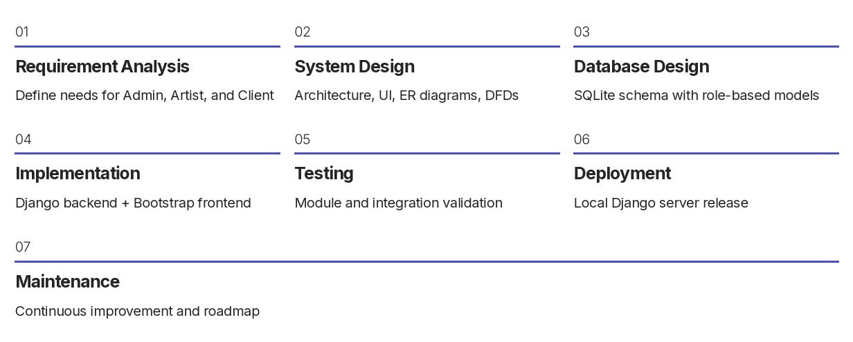
Methodology

Slide 4
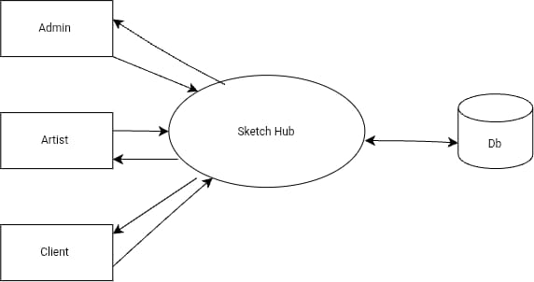
DFD — Level 0
Artists
Create profiles & select art categories
Upload artwork galleries & set prices
Communicate with clients via chat
Clients
Search artists by name, category, or district
View profiles and artwork galleries
Contact via chat or phone
Admin
Manage artists, clients & categories
Approve or reject artist profiles
Handle reports & complaints

Slide 5
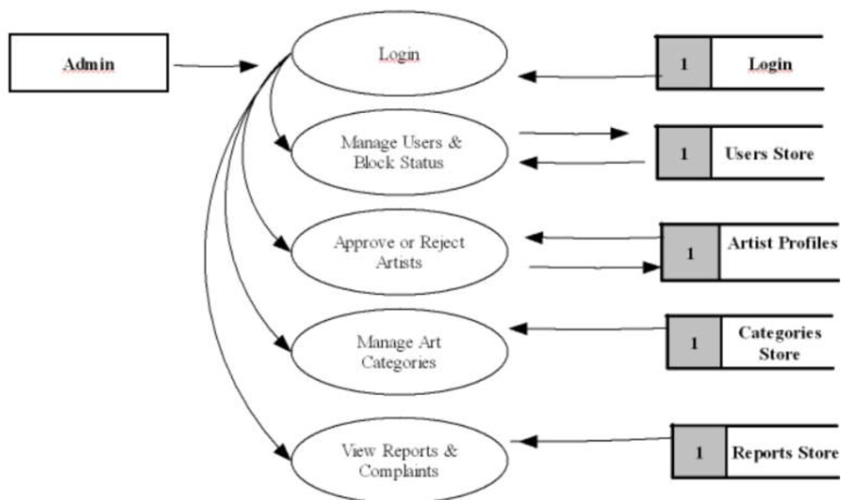
DFD — Level 1: Admin Module
Context diagram showing all Admin interactions with the SketchHub system:
Login
Admin authentication & access control
Manage Users & Block Status
Control user accounts and permissions
Approve / Reject Artists
Verify artist profiles before activation
Manage Art Categories
Create and organize art mediums
View Reports & Complaints
Monitor and resolve user issues

Slide 6
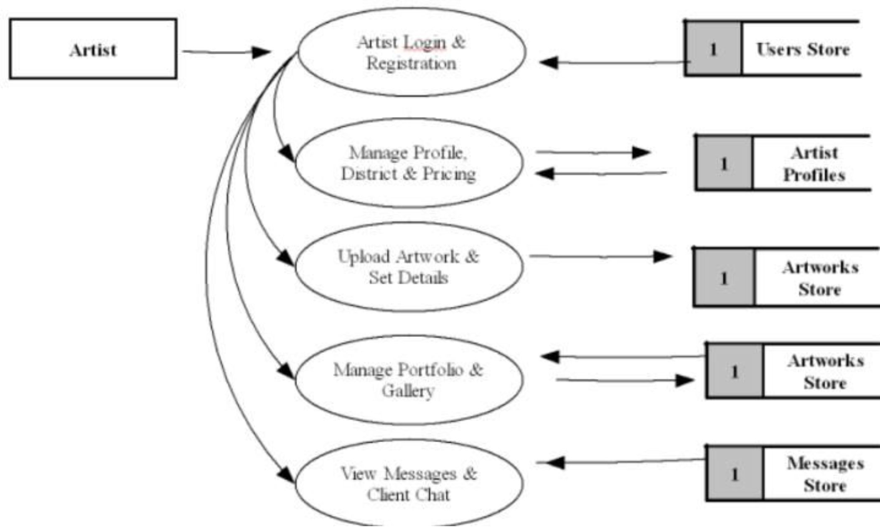
DFD — Level 2: Artist Module
Detailed data flows for all Artist interactions within SketchHub:
1
Login & Registration
Artist account creation and authentication
2
Manage Profile
Update bio, district, and starting price
3
Upload Artwork
Add artwork with details and pricing
4
Portfolio & Gallery
Organize and showcase artwork collections
5
View Messages
Chat with clients and manage inquiries

Slide 7
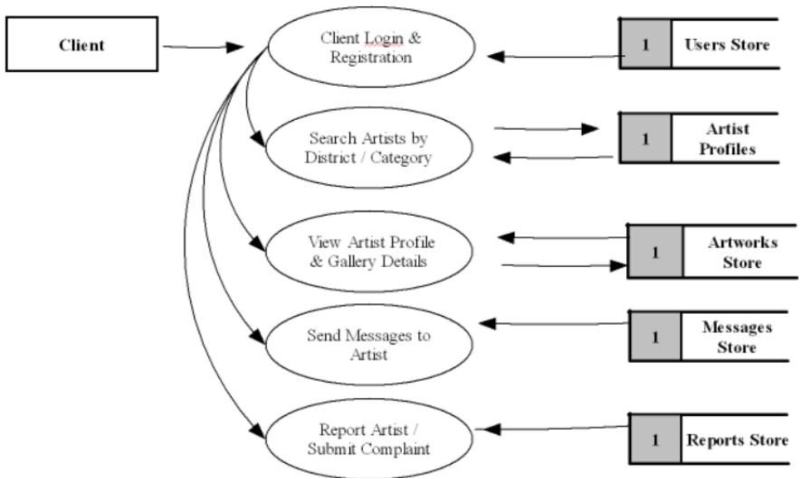
DFD — Level 3: Client Module
Detailed data flows for all Client interactions within SketchHub:
Login & Registration
Client account setup and authentication
Search Artists
Find by district, category, or artist name
View Profiles & Gallery
Browse artist details and artwork portfolios
Send Messages
Direct communication with artists
Report Artist
Submit complaints and feedback to Admin

Slide 8
Database Tables — Specifications
users Table (Master User Credentials & Roles)
Field Name | Data Type | Constraints | Description
user_id | INT | PRIMARY KEY, AUTO_INCREMENT | Unique User ID
name | VARCHAR(100) | NOT NULL | Full Name
email | VARCHAR(150) | UNIQUE, NOT NULL | Email Address (Login)
password_hash | VARCHAR(255) | NOT NULL | Encrypted Password
role | ENUM | 'admin', 'artist', 'client' | Account Role
phone | VARCHAR(20) | NULLABLE | Phone Number
status | ENUM | 'pending', 'active', 'blocked' | Account Status
created_at | TIMESTAMP | DEFAULT CURRENT_TIMESTAMP | Registration Date

Slide 9
2. artist_profiles Table (Artist Details)
Field Name | Data Type | Constraints | Description
artist_id | INT | PRIMARY KEY, AUTO_INCREMENT | Profile ID
user_id | INT | FOREIGN KEY (users.user_id) | Links to Master User
bio | TEXT | NULLABLE | Artist Biography
district | VARCHAR(100) | NOT NULL | Location / District
starting_price | DECIMAL(10,2) | DEFAULT 0.00 | Base Commission Rate
profile_pic | VARCHAR(255) | NULLABLE | Image Path / URL
3. categories Table (Art Mediums)
Field Name | Data Type | Constraints | Description
category_id | INT | PRIMARY KEY, AUTO_INCREMENT | Category ID
category_name | VARCHAR(100) | UNIQUE, NOT NULL | Category Name
description | TEXT | NULLABLE | Category Description

Slide 10
4. artist_categories Table (Junction Table)
Field Name | Data Type | Constraints | Description
artist_id | INT | FOREIGN KEY (artist_profiles.artist_id) | Artist ID
category_id | INT | FOREIGN KEY (categories.category_id) | Category ID
5. artworks Table (Gallery & Portfolio Items)
Field Name | Data Type | Constraints | Description
artwork_id | INT | PRIMARY KEY, AUTO_INCREMENT | Artwork ID
artist_id | INT | FOREIGN KEY (artist_profiles.artist_id) | Artwork Owner
category_id | INT | FOREIGN KEY (categories.category_id) | Linked Art Category
title | VARCHAR(150) | NOT NULL | Artwork Title
description | TEXT | NULLABLE | Artwork Description
price | DECIMAL(10,2) | NOT NULL | Selling Price
image_url | VARCHAR(255) | NOT NULL | Cloud / Server Path
created_at | TIMESTAMP | DEFAULT CURRENT_TIMESTAMP | Upload Time

Slide 11
6. messages Table (Chat Conversations)
Field Name | Data Type | Constraints | Description
message_id | INT | PRIMARY KEY, AUTO_INCREMENT | Message ID
sender_id | INT | FOREIGN KEY (users.user_id) | Message Sender
receiver_id | INT | FOREIGN KEY (users.user_id) | Message Receiver
message_text | TEXT | NOT NULL | Text Content
sent_at | TIMESTAMP | DEFAULT CURRENT_TIMESTAMP | Timestamp
7. reports Table (Complaints Queue)
7. reports Table (Complaints Queue)Field Name | Data Type | Constraints | Description
report_id | INT | PRIMARY KEY, AUTO_INCREMENT | Report ID
reporter_id | INT | FOREIGN KEY (users.user_id) | Client ID
reported_artist_id | INT | FOREIGN KEY (artist_profiles.artist_id) | Flagged Artist
reason | TEXT | NOT NULL | Complaint Details
status | ENUM | 'pending', 'resolved' | Moderation Status
created_at | TIMESTAMP | DEFAULT CURRENT_TIMESTAMP | Logged Date

Slide 12
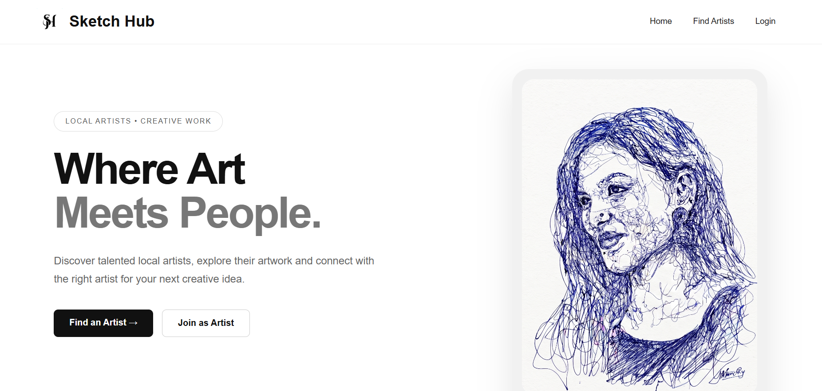
Screenshots of the Project

Slide 13
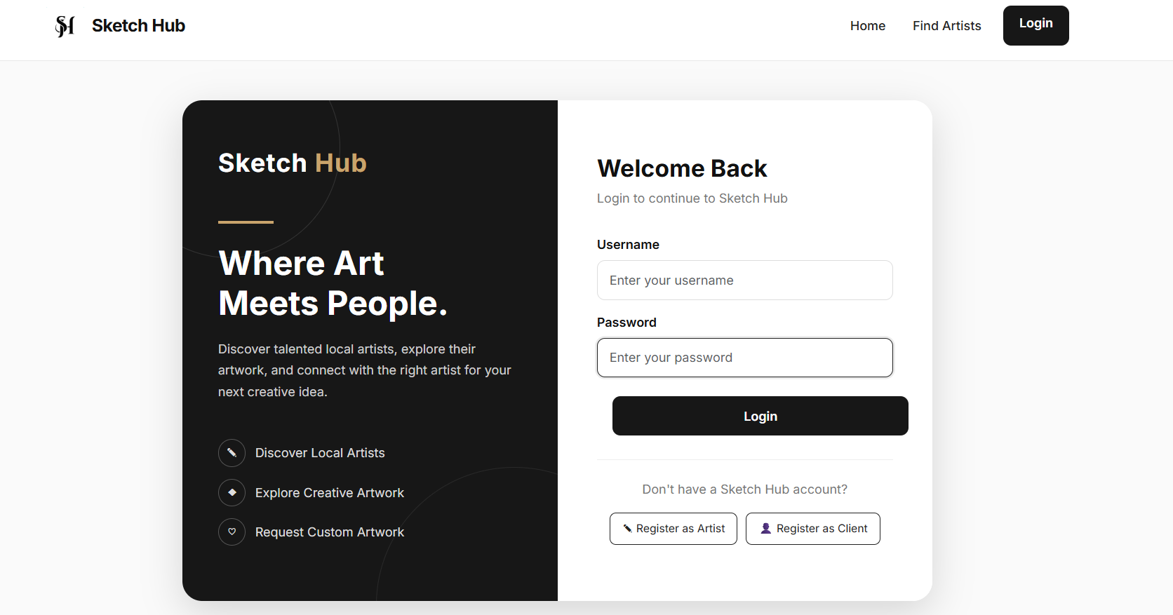

Slide 14
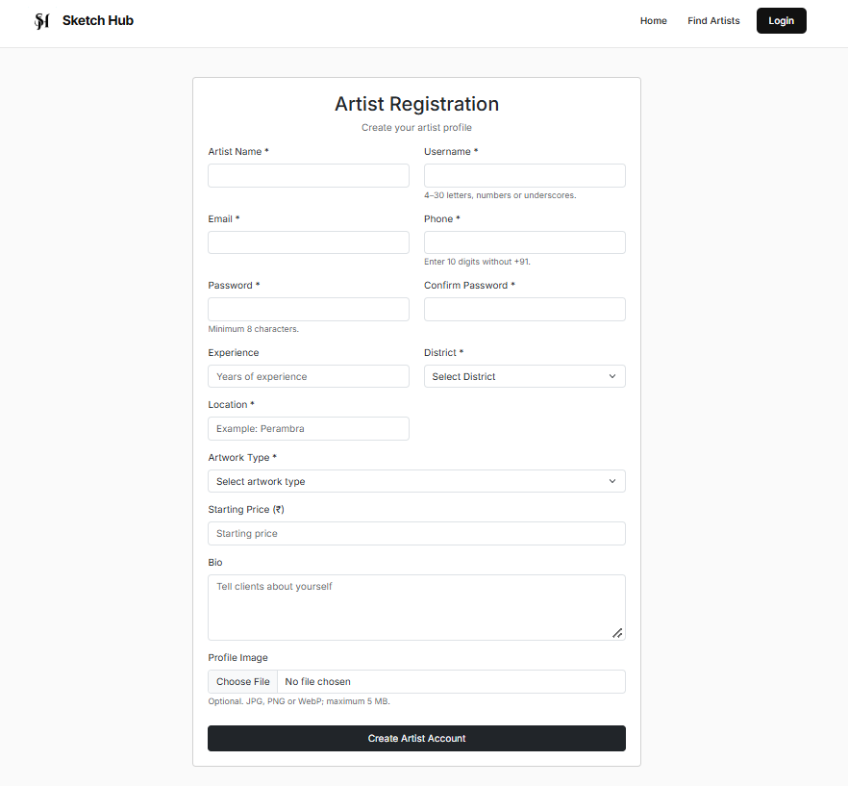
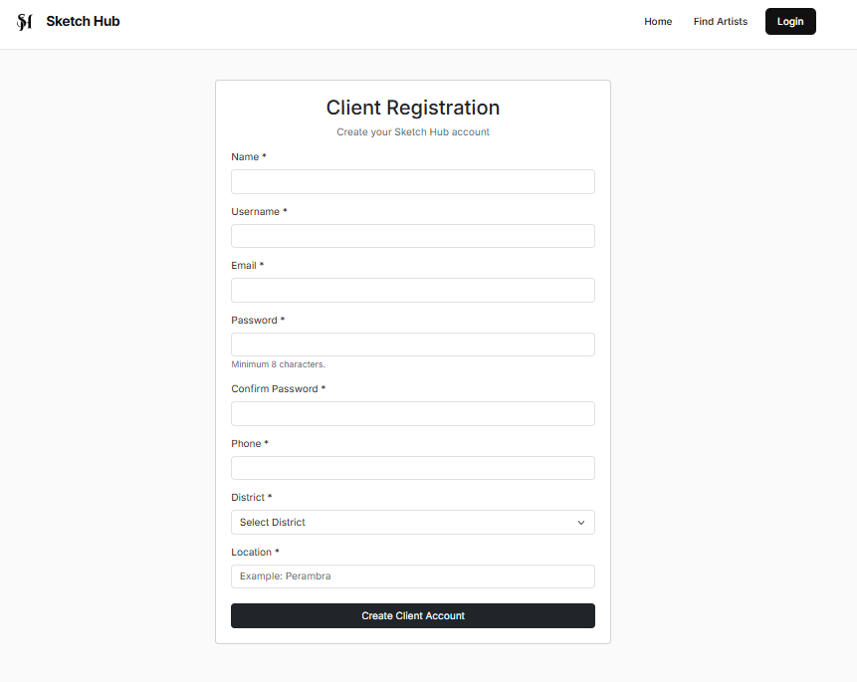

Slide 15
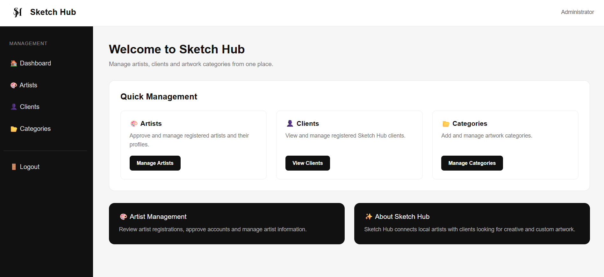

Slide 16
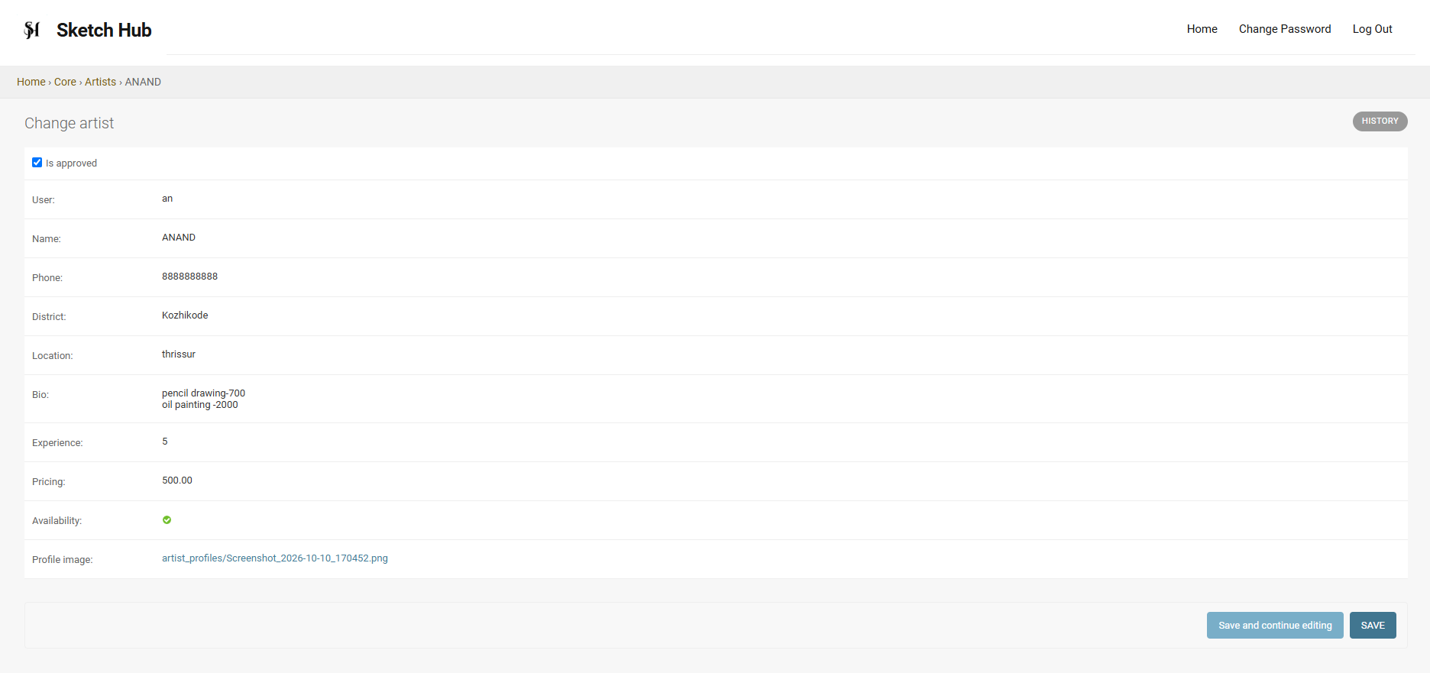

Slide 17
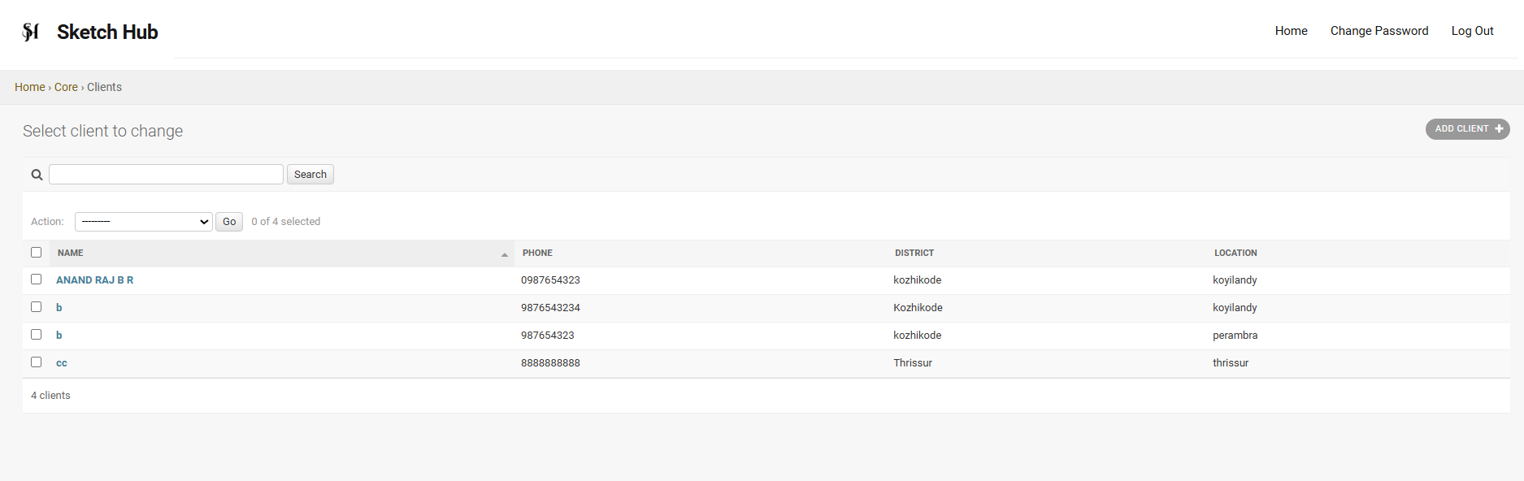

Slide 18
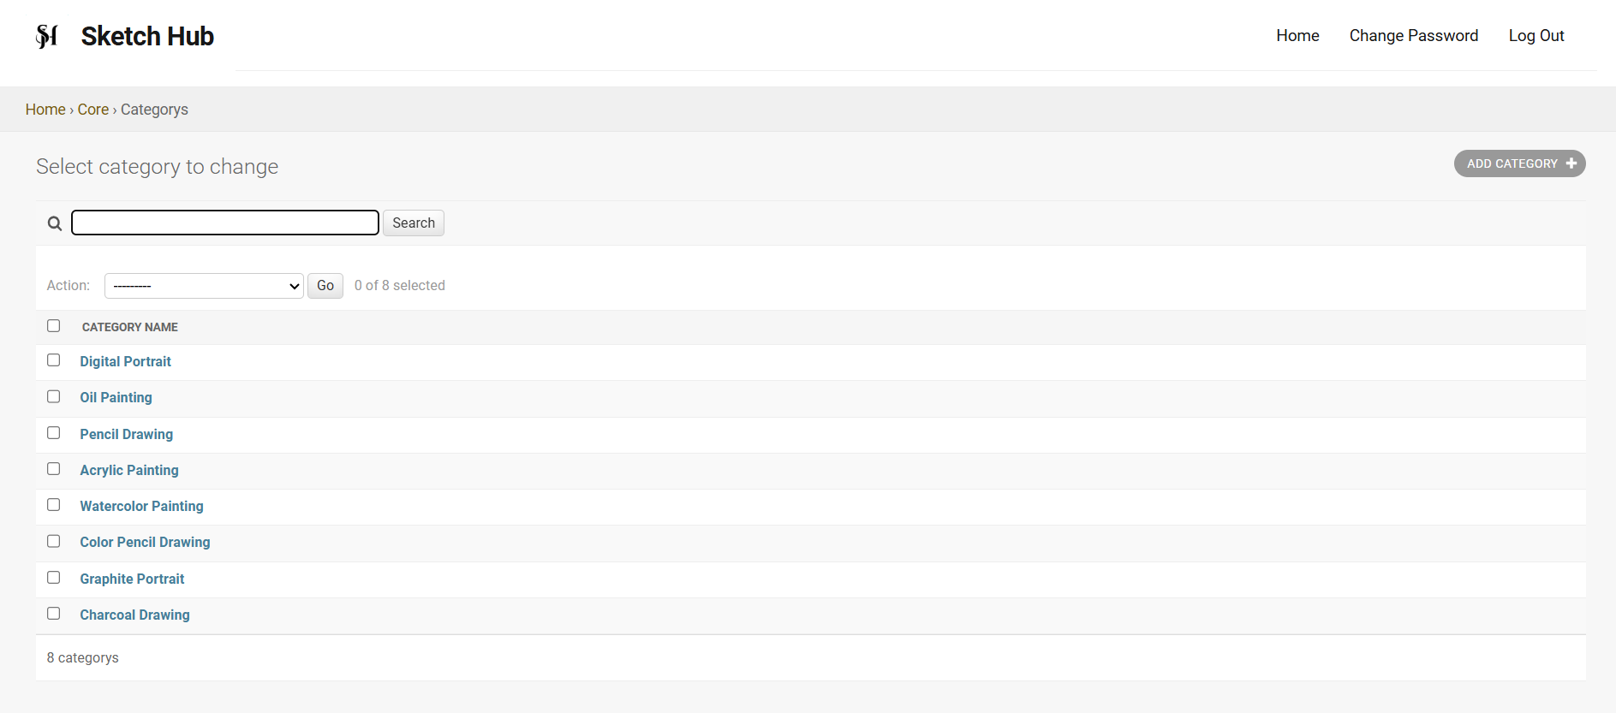

Slide 19
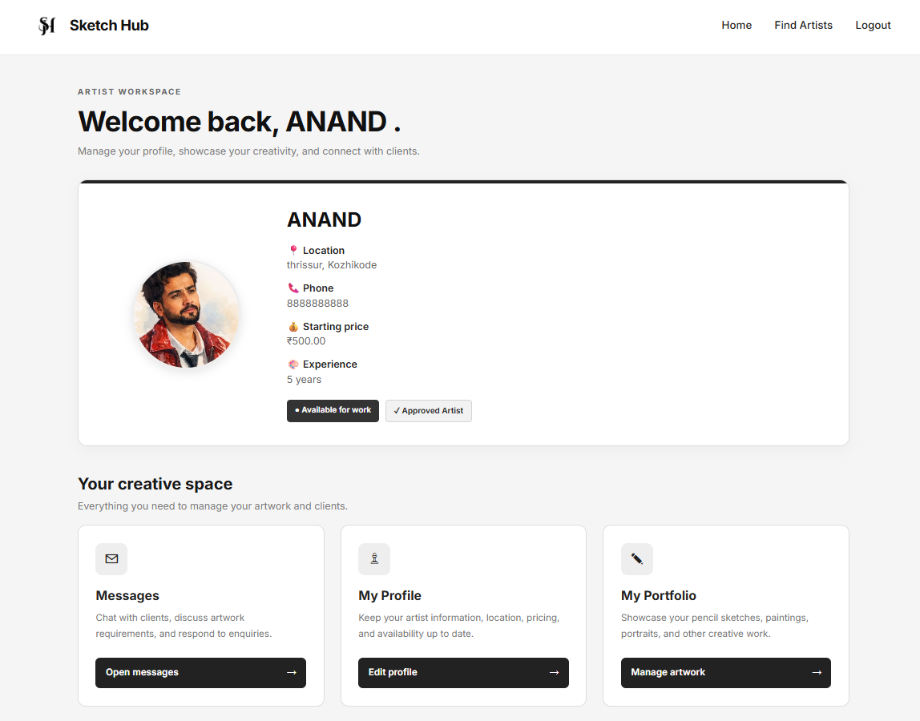

Slide 20
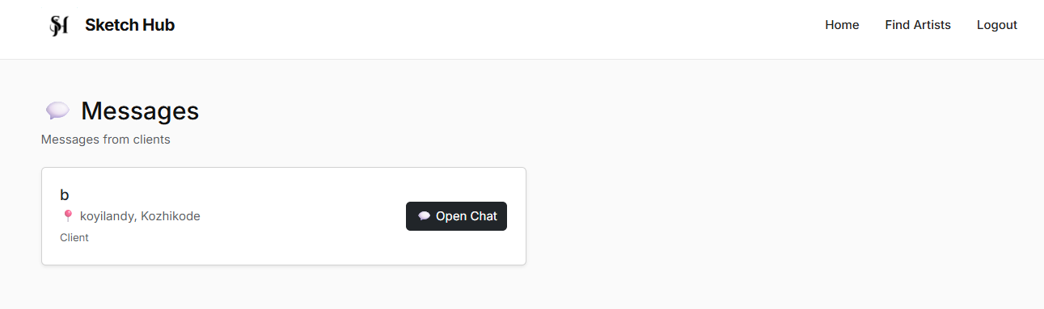
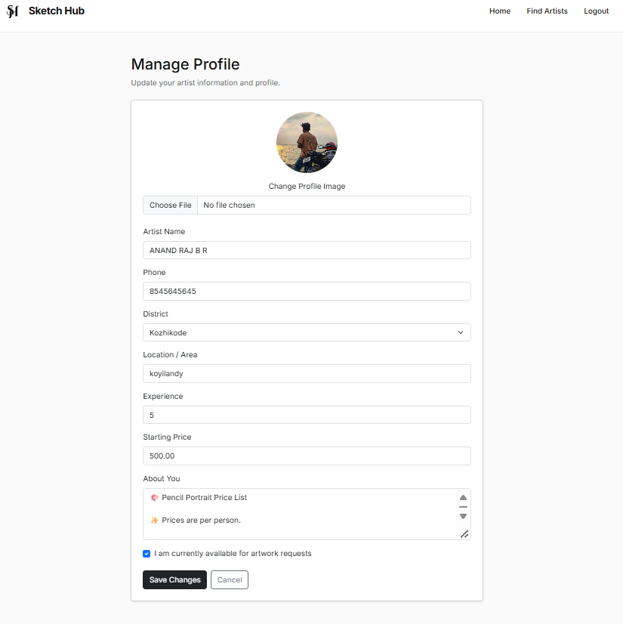
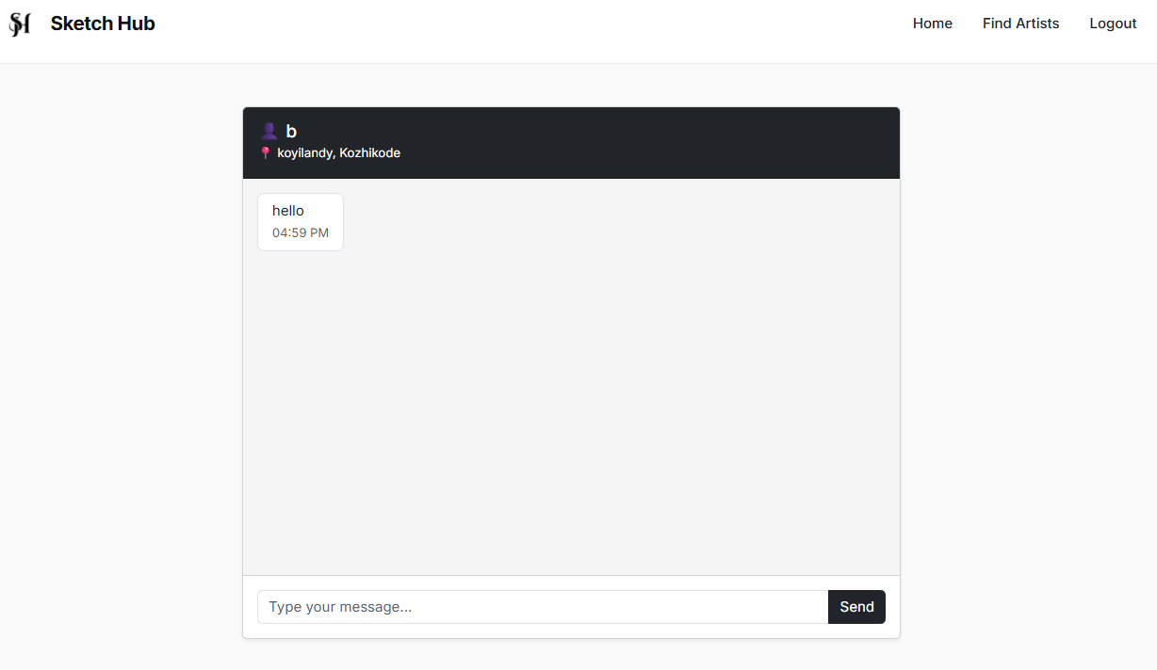

Slide 21
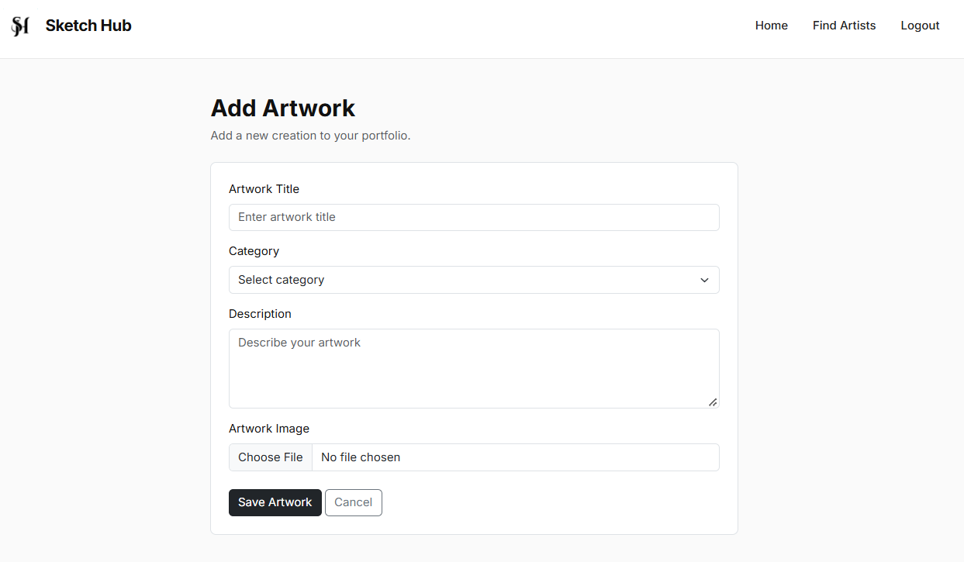

Slide 22
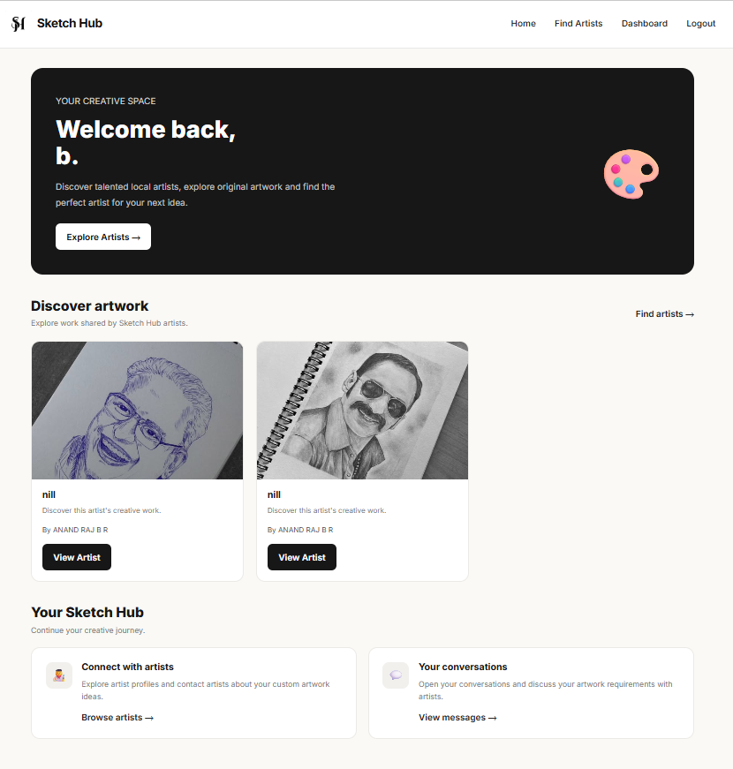

Slide 23
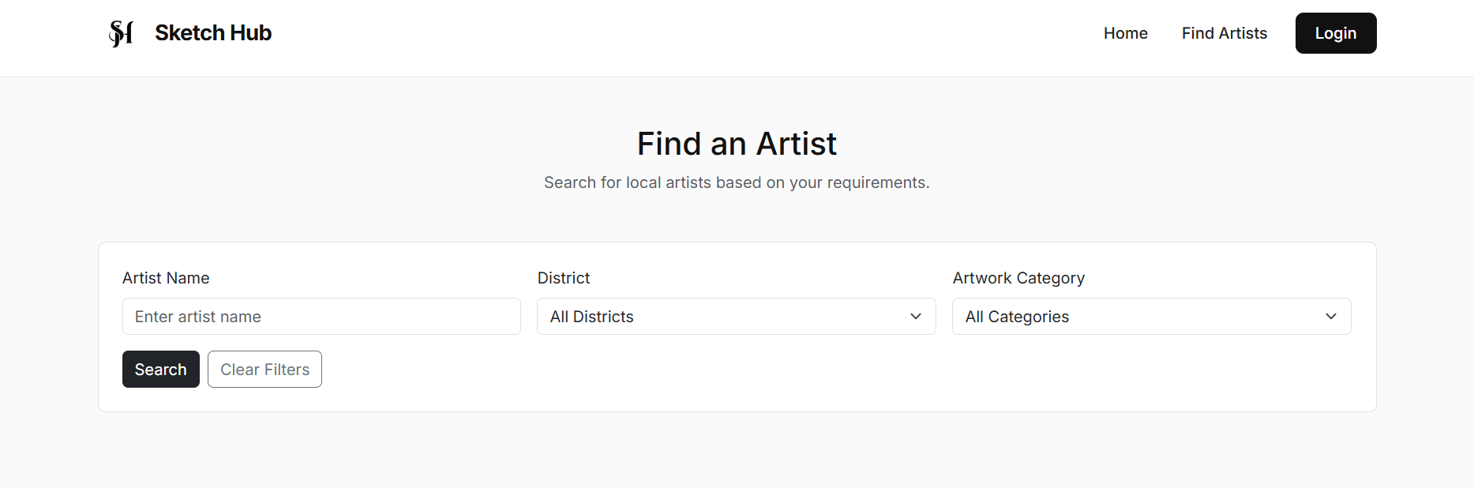

Slide 24
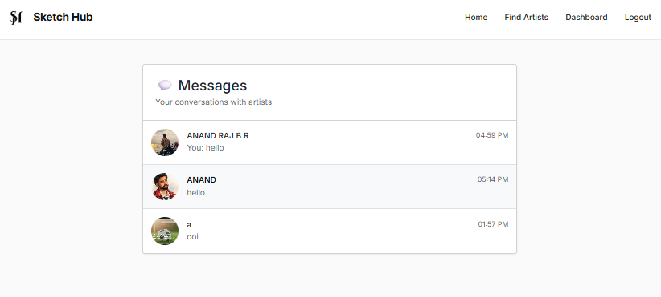
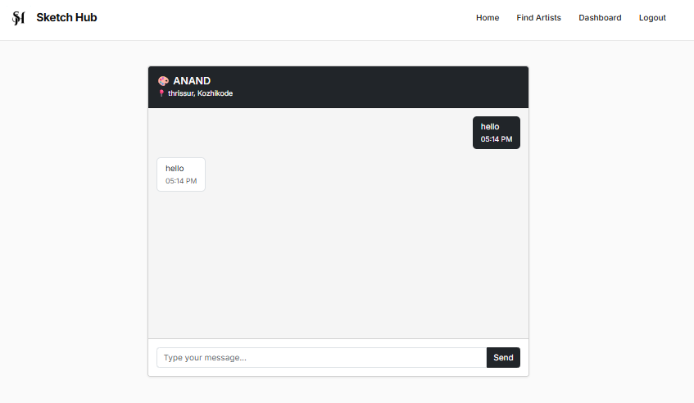

Slide 25


